Slide 1
GRAIN PALETTE -
A deep learning Odyssey in rice type classification through transfer.
Project Supervisor: Ganesh M
Team Leader : Jais Meyar Mulpuru Team member : Kavuri Shaik Afrin Team member : Kokkiligadda Sirisha Team member : Kommineni Devika
Team ID : LTVIP2025TMID33603

Slide 2
Introduction to Grain Palette A grain palette refers to a curated selection of grains used in cooking, baking, or brewing to create diverse flavors, textures, and nutritional profiles. Much like an artist’s color palette, a grain palette offers variety and balance, allowing chefs, bakers, and brewers to craft specific culinary or sensory outcomes.

Slide 3
1. Definition A grain palette is a conceptual or physical collection of different grains, which may include: Whole grains (e.g., brown rice, quinoa, millet) Refined grains (e.g., white flour, white rice) Ancient grains (e.g., farro, spelt, amaranth) Specialty grains (e.g., black rice, red quinoa, freekeh)

Slide 4
2. Purpose The grain palette is used for: Culinary diversity: To enhance taste, texture, and presentation. Nutritional variety: Different grains offer varying levels of fiber, protein, vitamins, and minerals. Cultural expression: Grains are integral to regional cuisines (e.g., couscous in North Africa, barley in Northern Europe).

Slide 5
3. Examples in Use Cooking: A chef may select quinoa, wild rice, and bulgur for a hearty grain bowl. Baking: A baker might combine wheat, rye, and oats to develop flavor and structure in bread. Brewing: Brewers often work with a grain palette of barley, wheat, and oats to create different beer styles.

Slide 6
4. Building a Grain Palette When creating your own palette, consider: Flavor: Earthy, nutty, sweet, or neutral. Texture: Chewy, soft, fluffy, or crunchy. Color: White, red, black, golden, etc. Cooking time: Some grains take longer to cook than others.

Slide 7
Ideation phase
The Ideation Phase of a grain palette project is where you creatively explore and define the conceptual and visual direction for how grains (like wheat, rice, barley, millet, etc.) will be represented in a design context—whether for branding, packaging, interior design, culinary projects, or agricultural education. Here's a breakdown of how to approach this phase:
The Ideation Phase of a grain palette project is where you creatively explore and define the conceptual and visual direction for how grains (like wheat, rice, barley, millet, etc.) will be represented in a design context—whether for branding, packaging, interior design, culinary projects, or agricultural education. Here's a breakdown of how to approach this phase:

Slide 8
1. Define the Purpose and Context What is the grain palette for? Branding (e.g., for a bakery or farm) Product design (e.g., food packaging) Interior/UX palette (e.g., natural colors/textures) Educational materials (e.g., infographics, charts)

Slide 9
2. Brainstorm Visual Themes Consider how to visually represent grains: Natural elements: husks, kernels, stalks, fields Colors: muted earth tones, hues, creamy whites, dusty greens Textures: rough (bran), smooth (polished rice), fibrous (stalks)

Slide 10
3. Explore Color and Material Inspiration Build a color palette inspired by: Real grains (e.g., red quinoa, golden oats) Fields and seasons (e.g., harvest gold, spring green) Complementary elements (e.g., wooden bowls, stone mills)

Slide 11
4. Create Mood Boards or Concept Clusters Organize ideas into visual clusters: Minimalist organic: clean whites and beiges, focus on grain purity Rustic farmhouse: warm browns, wood, linen textures Global grain: rich saffron, indigo, deep brown from world cuisines

Slide 12
5. Research Trends and References Sustainable food branding Natural/organic product packaging Grain-focused restaurants or bakeries (e.g., Tartine, Noma) Agricultural co-ops or grain-focused design systems (e.g., heirloom grain catalogs)

Slide 13
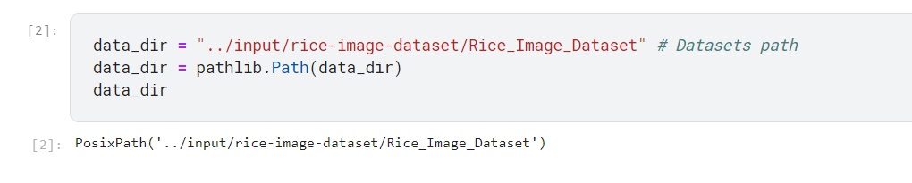

Slide 14
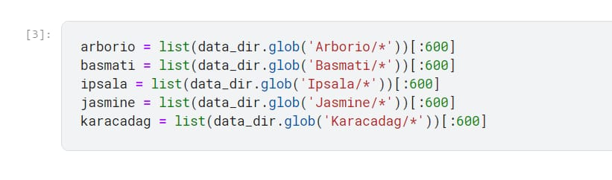

Slide 15
✅ Requirement Analysis of a Grain Palette The requirement analysis phase defines what the grain palette needs to accomplish, who it's for, and how it will be used. It ensures your design or product development is aligned with the objectives, constraints, and user needs.

Slide 16
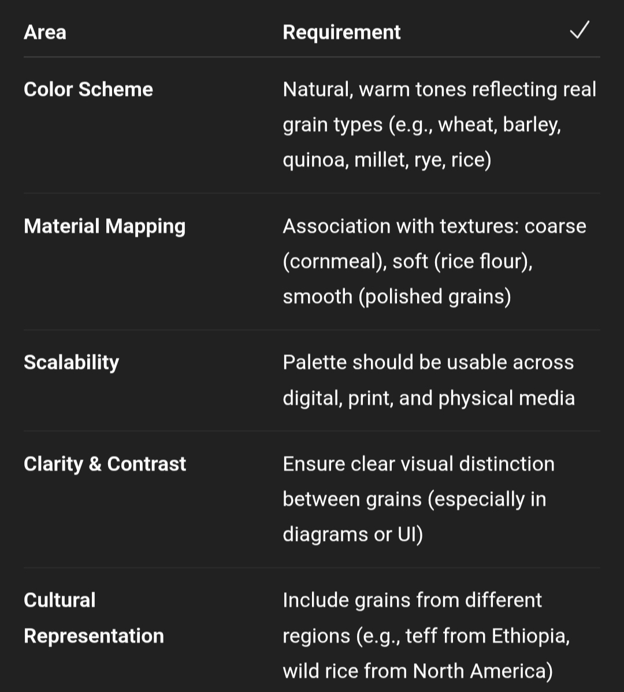

Slide 17
